Slide 1
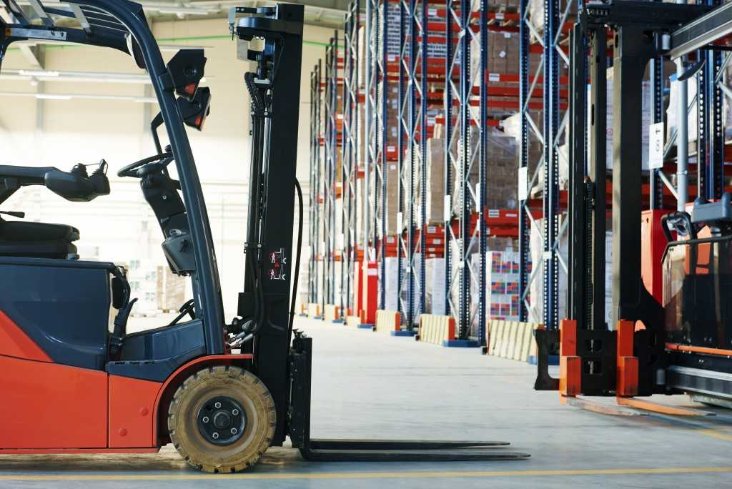
Industrial Lift Trucks 1910.178
Michelle Smith | Safety Consultant Principal
Workplace Safety Consultation

Slide 2
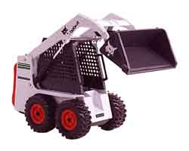
Powered Industrial Truck Definition
An industrial vehicle that carries, pushes, pulls, stacks or tiers loads.
Include fork trucks, platform lift trucks, motorized hand trucks, and other specialized industrial trucks powered by electric motors or internal combustion engines.
Excludes vehicles that are used for earth-moving or over the road hauling and compressed air or nonflammable compressed gas-operated industrial trucks

Slide 3
Classes of Commonly-Used Powered Industrial Trucks
The Industrial Truck Association has placed powered industrial trucks into 7 classes:
Class I - Electric motor rider trucks
Class II - Electric motor narrow aisle trucks
Class III - Electric motor hand trucks or hand/rider trucks
Class IV - Internal combustion engine trucks (solid/cushion tires)
Class V - Internal combustion engine trucks (pneumatic tires)
Class VI - Electric and internal combustion engine tractors
Class VII - Rough terrain forklift trucks
Note that this classification refers to commonly-used vehicles and does not include all powered industrial trucks covered by the OSHA standard.

Slide 4
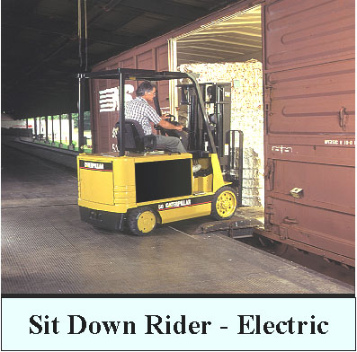
Classes of Commonly Used Powered Industrial Trucks
Class I – Electric Motor Rider Trucks

Slide 5
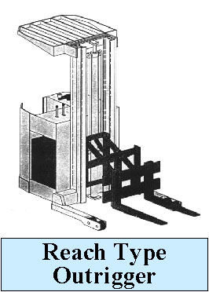
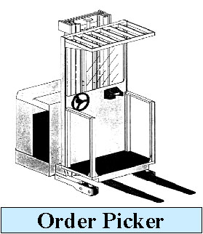
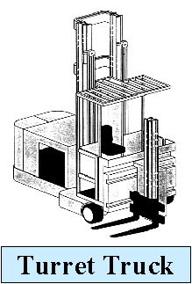
Classes of Commonly Used Powered Industrial Trucks
Class II – Electric Motor Narrow Aisle Trucks

Slide 6
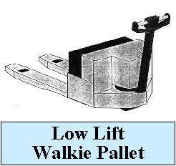
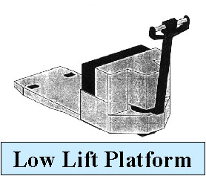
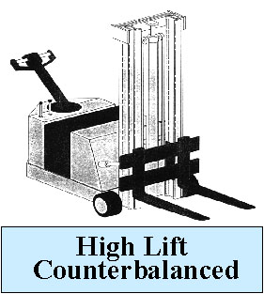
Classes of Commonly Used Powered Industrial Trucks
Class III – Electric Motor Hand Trucks or Hand / Rider Trucks

Slide 7
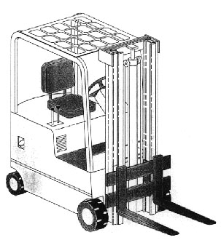
Classes of Commonly Used Powered Industrial Trucks
Class IV – Internal Combustion Engine trucks (solid / cushion tires)

Slide 8
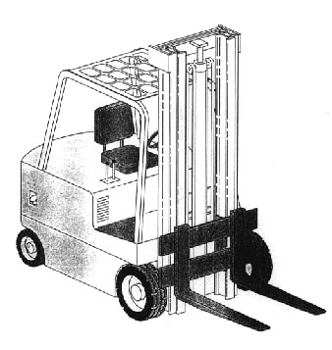
Classes of Commonly Used Powered Industrial Trucks
Class V – Internal Combustion Engine Trucks (pneumatic tires)

Slide 9
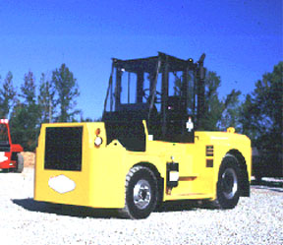
Classes of Commonly Used Powered Industrial Trucks
Class VI – Electric and Internal Combustion Engine Tractors

Slide 10
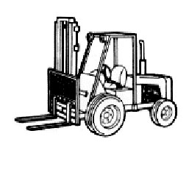
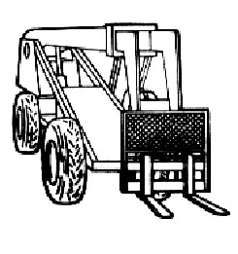
Classes of Commonly Used Powered Industrial Trucks
Class VII – Rough Terrain Forklift Trucks

Slide 11
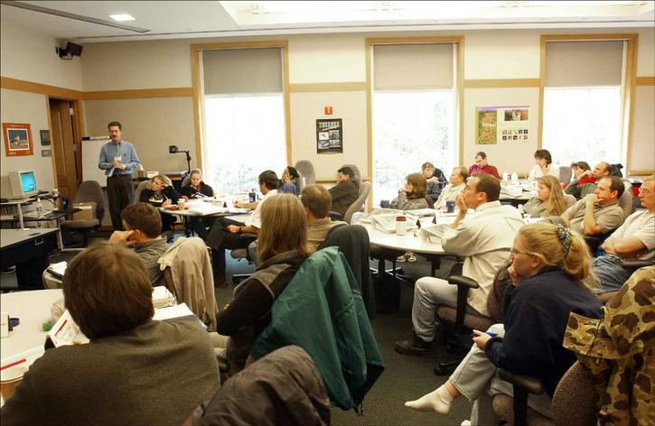
Employer Responsibilities
Provide employees with training and evaluation once every three years, after a near-miss or an accident, and if an employee has been observed operating a forklift in an unsafe manner (i.e., horseplay)
Employer is to document and certify that employee has been trained and evaluated on forklift operations. The certification records need to be maintained including a copy of the test, the training provided, and evaluation of the driving.

Slide 12
Employer Responsibilities
Enforce forklift safety rules and follow disciplinary procedures when necessary.
Ensure that pre-shift inspections are being conducted and lifts found to be deficient are taken out of service until repaired.

Slide 13
Training Requirements – Truck Related Topics
Operating instructions, warnings, and precautions for the types of truck the operator will be authorized to operate
Differences between the truck and the automobile
Truck controls and instrumentation: where they are located, what they do and how they work
Engine or motor operation
Steering and maneuvering
Visibility (including restrictions due to loading)
Fork and attachment adaptation, operation, and use limitations
Vehicle capacity
Vehicle stability (Stability Triangle)
Any vehicle inspection and maintenance that the operator will be required to perform
Refueling and/or charging and recharging of batteries
Operating limitations

Slide 14
Training Requirements – Workplace Related Topics
Surface conditions where the vehicle will be operated
Composition of loads to be carried and load stability
Load manipulation, stacking and unstacking
Pedestrian traffic in areas where the vehicle will be operated
Narrow aisles and other restricted places where the vehicle will be operated
Hazardous (classified) locations where the vehicle will be operated
Ramps and other sloped surfaces that could affect the vehicle's stability
Closed environments and other areas where insufficient ventilation or poor vehicle maintenance could cause a buildup of carbon monoxide or diesel exhaust
Other unique or potentially hazardous environmental conditions in the workplace that could affect safe operations

Slide 15
Training Requirements
If an operator was previously trained in one or more of these topics, and the training is appropriate to the truck and working conditions encountered, additional training on that topic is not required if the operator has been evaluated and found competent to operate the truck safely.
Trainees may operate a powered industrial truck only:
Under the direct supervision of persons who have the knowledge, training, and experience to train operators and evaluate their competence.
Where such operation does not endanger the trainee or other employees.

Slide 16
Truck Operations
Do not drive up to someone that could be pinned
Do not allow anyone to stand or walk under forks
Driver dismounted & within 25 ft. – forks lowered, controls neutralized & brakes set
Unattended – forks lowered, controls neutralized, power off and brake set
Unattended = lift not in view of operator or operator more than 25 ft. from lift
Wheels chocked

Slide 17
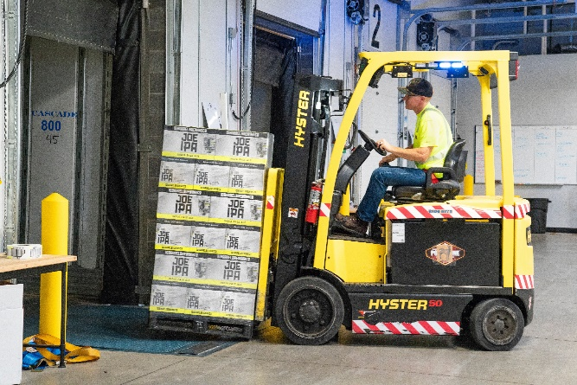
Traveling
Traffic Regulations Must Be Observed
Speed Limits, Safe Following Distance, Horn Usage, RR Tracks
No Horseplay / Stunt Driving
Dockboards / Bridgeplates
Loads & Rated Capacity
Stabilization of Load

Slide 18
Operation of the Truck
Found to be in need of repair, defective or unsafe then needs to be taken out of service
Trucks should be examined before being put into service each shift.
Truck can be altered only if authorized by the manufacturer. Maintain records of the alteration and authorization.

Slide 19
MN Rule 5205.116
Monitor employee’s exposure to carbon monoxide where internal combustion engine powered industrial trucks are operated indoors to ensure carbon monoxide levels do not exceed 35 ppm as an eight hour time-weighted average or 200 ppm as a five minute ceiling average.
Air monitoring shall be done at least quarterly and during highest usage. Document the results.
The employer shall ensure that powered industrial truck engine exhaust gases do not contain more than one percent carbon monoxide for propane fueled trucks or two percent carbon monoxide for gasoline fueled trucks measured at idle and at three-fourths throttle during final engine tuning in a regular maintenance program.

Slide 20
?QUESTIONS?

Slide 21
Workplace Safety Consultation Service
Improve a company’s safety and health program
Free safety and health resources
Develop a relationship with a WSC consultant
No citations, fines or penalties
Exempt from a programmed MNOSHA Compliance visit during Consultation period
Required to correct Serious Hazards or Imminent Dangers

Slide 22
Thank You!
Michelle Smith
michelle.smith@state.mn.us

